Slide 1

VIDEO GAME ANALYSIS

Slide 2
Objectives
Analyze global video game performance by exploring sales trends, platform popularity, and regional preferences using structured datasets.
Evaluate player engagement and ratings.
Combine sales and engagement insights to understand how user interest correlates with commercial success.
Develop an interactive Power BI dashboard that provides actionable insights

Slide 3

Data Overview
The two dataset contains information of games, sales, publisher, etc.
There are attributes like- Team, Title, Release date, Publisher, etc.

Slide 4
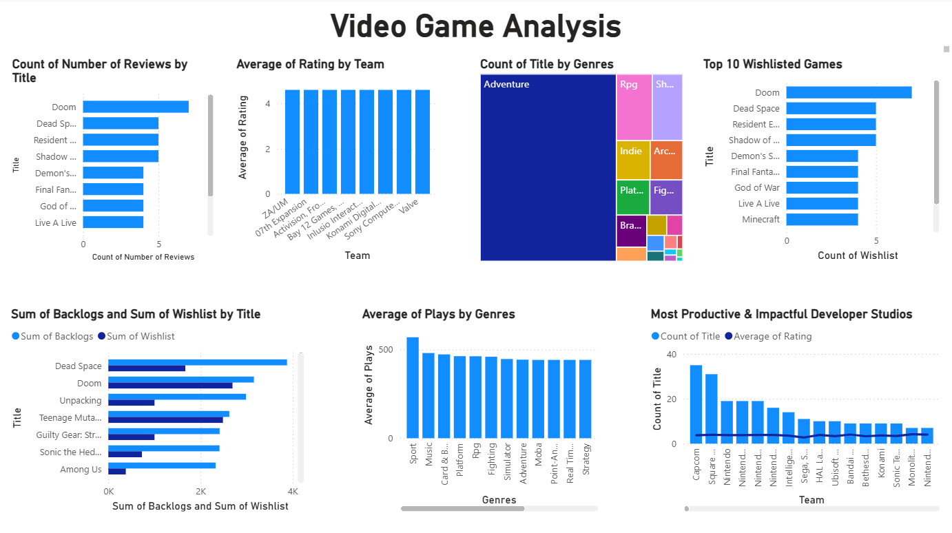
Dashboard 1- Games

Slide 5
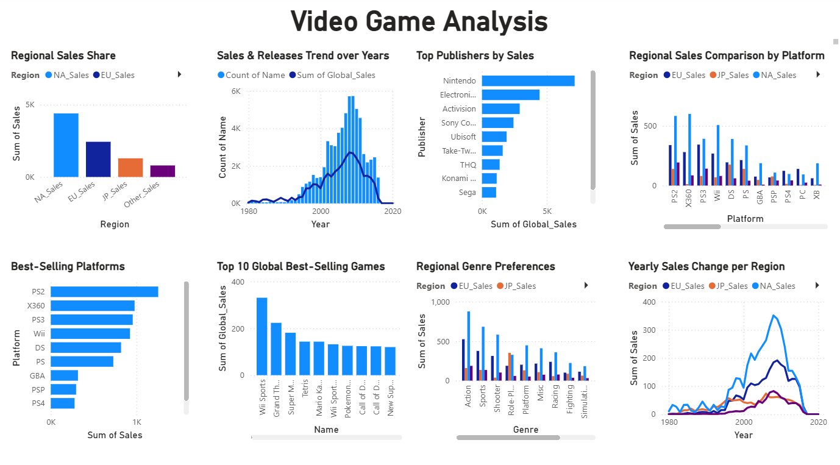
Dashboard 2- sales

Slide 6
Recommendations to increase bike sales
Adventure and RPG genres dominate user engagement, suggesting that future game development could focus more on narrative-driven and role-playing elements to maximize player interest.
Doom, Dead Space, and Resident Evil are among the most wishlisted and reviewed games, highlighting strong brand recognition and replay value. Studios can use this to guide sequel or remaster priorities.
Developers like Capcom, Square Enix, and Nintendo show both high productivity and strong ratings, indicating that consistent releases with quality assurance lead to higher user trust and satisfaction.
Backlog vs. Wishlist analysis reveals demand–engagement gaps; for example, high wishlists but low play counts could suggest either accessibility issues or pricing barriers worth investigating.
Sports and Music genres have the highest average plays, reflecting strong replay potential — ideal for games-as-a-service (GaaS) or seasonal event-based models.

Slide 7
Thank you
HIMANSHU
Role: Data Analyst Intern
hiimanshuu0406@gmail.com

